Slide 1
Policy Doc
Notes:
More than 5 MB to be checked.

Slide 2

Notes:
More than 5 MB to be checked.

Slide 3
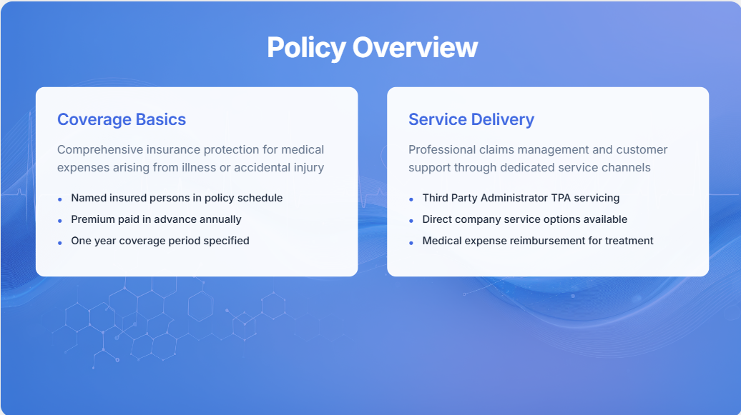
Notes:
https://app.powerbi.com/groups/me/reports/a1acbcca-df4c-40c8-a587-91405c143b3a/ReportSection33a4cc66ede13c4da0c0?experience=power-bi
B2C Dashboard – Akshay
Avg Consultation Cost

Slide 4
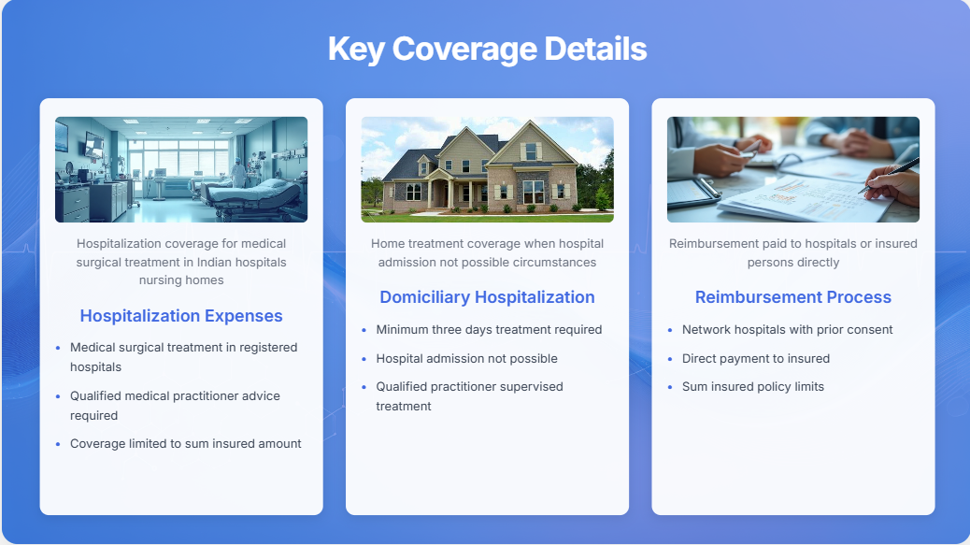
Notes:
More than 5 MB to be checked.

Slide 5
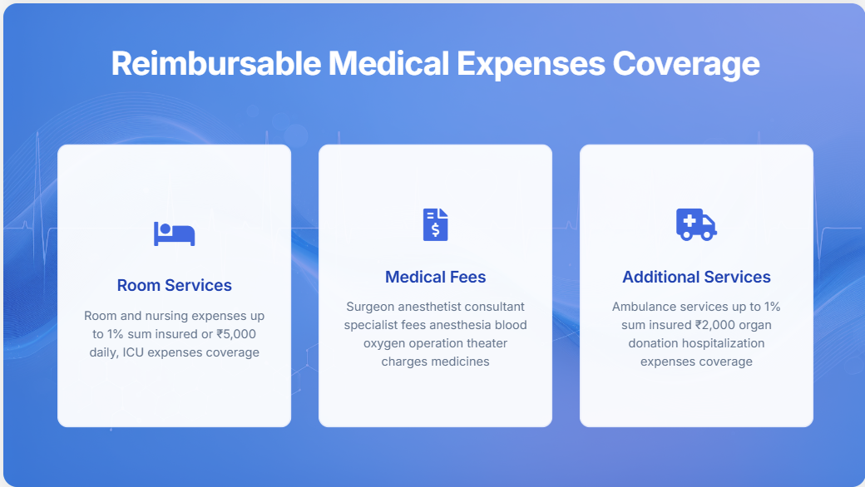

Slide 6
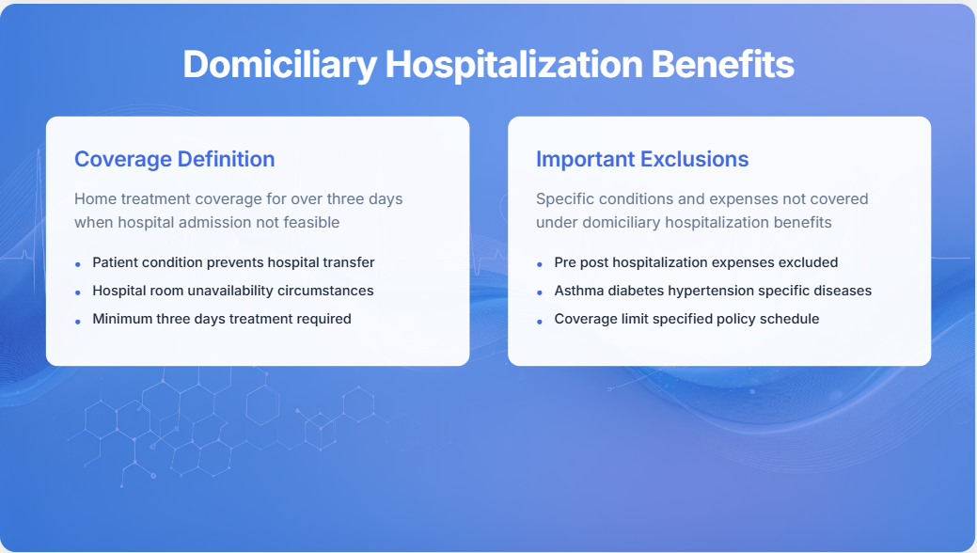

Slide 7
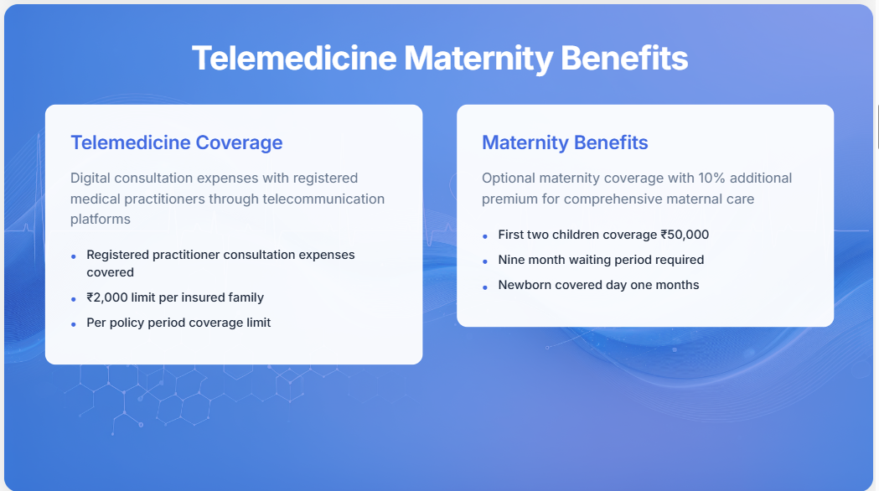

Slide 8
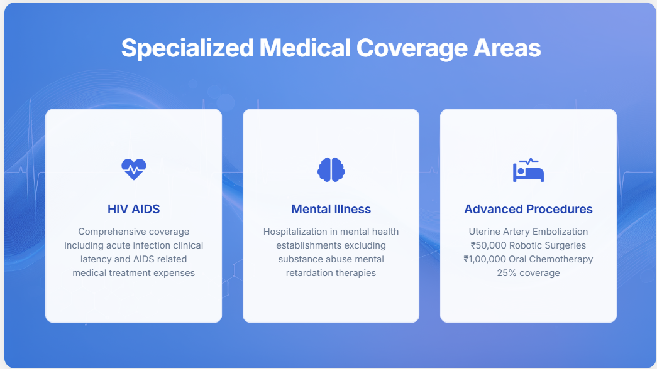
Notes:
https://app.powerbi.com/groups/me/reports/a1acbcca-df4c-40c8-a587-91405c143b3a/ReportSection33a4cc66ede13c4da0c0?experience=power-bi
B2C Dashboard – Akshay
Avg Consultation Cost

Slide 9
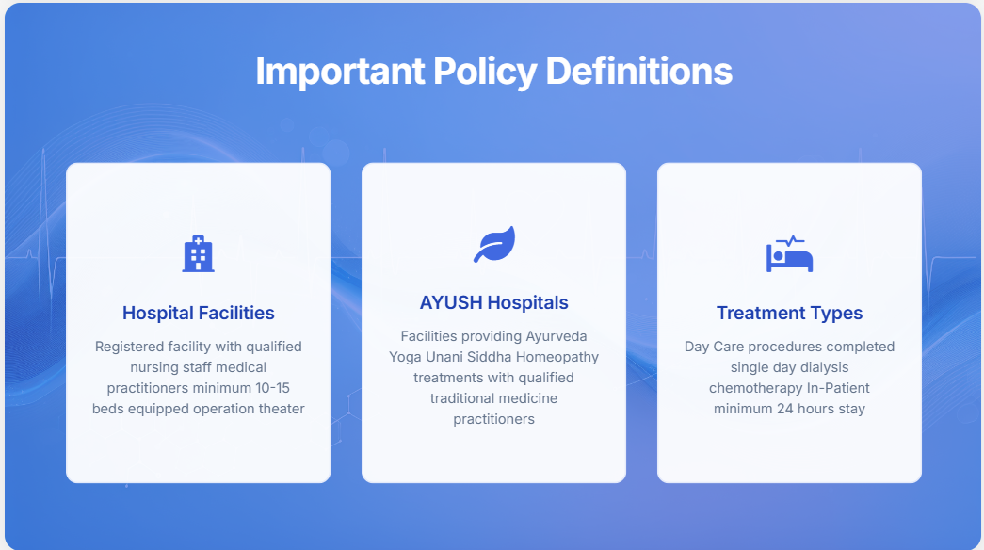
Notes:
https://app.powerbi.com/groups/me/reports/a1acbcca-df4c-40c8-a587-91405c143b3a/ReportSection33a4cc66ede13c4da0c0?experience=power-bi
B2C Dashboard – Akshay
Avg Consultation Cost

Slide 10
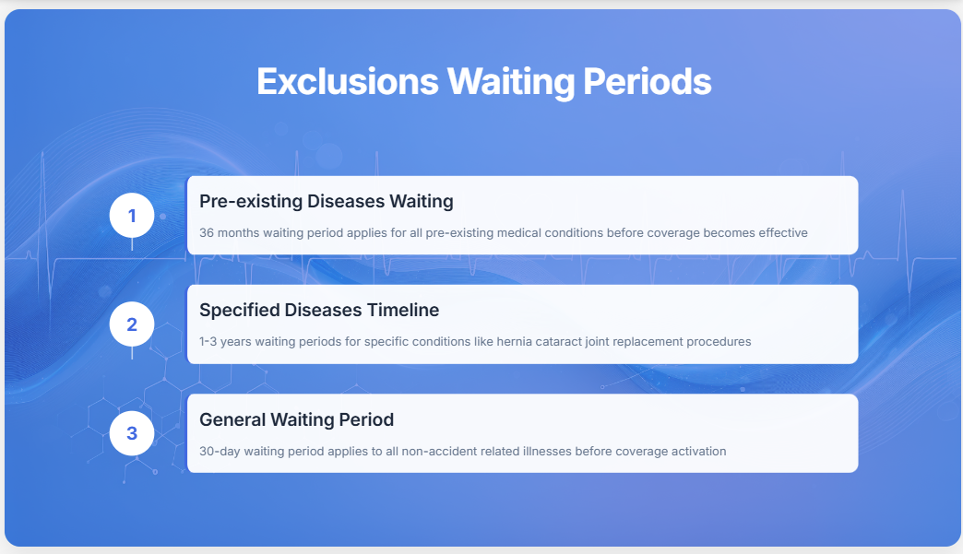
Notes:
https://app.powerbi.com/groups/me/reports/a1acbcca-df4c-40c8-a587-91405c143b3a/ReportSection33a4cc66ede13c4da0c0?experience=power-bi
B2C Dashboard – Akshay
Avg Consultation Cost

Slide 11
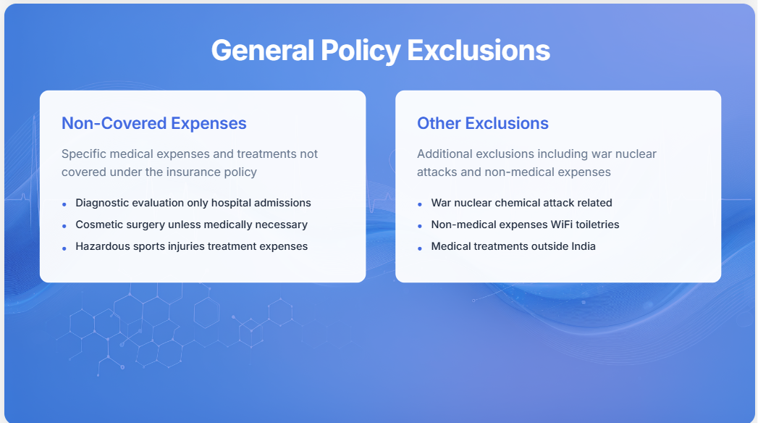

Slide 12
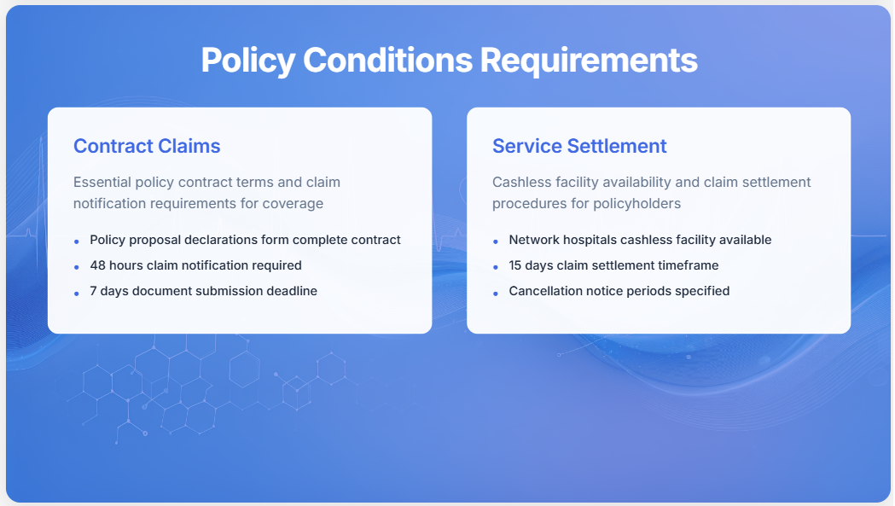
Notes:
More than 5 MB to be checked.

Slide 13
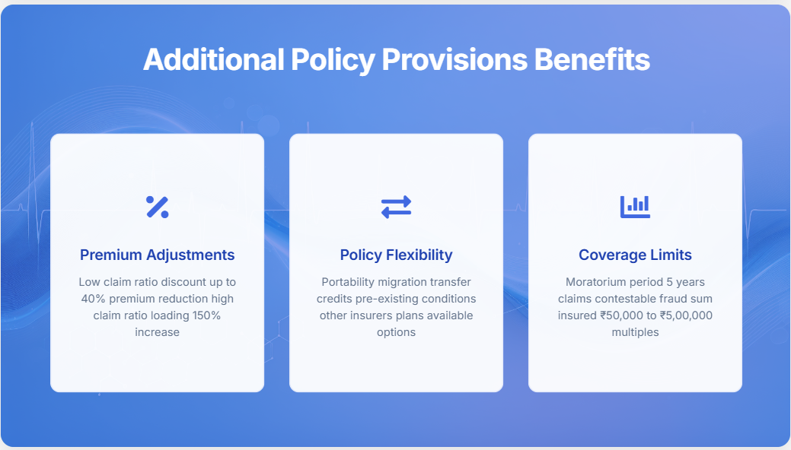

Slide 14
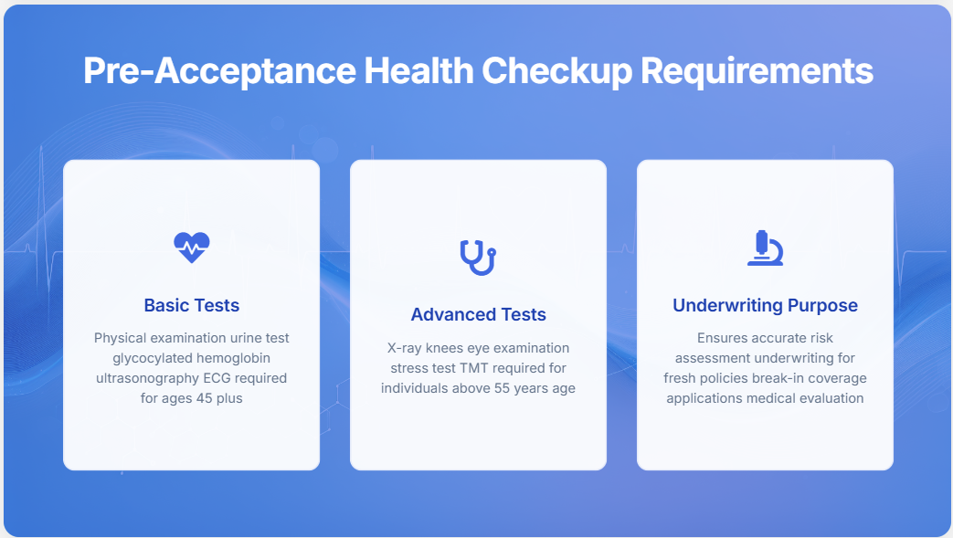

Slide 15
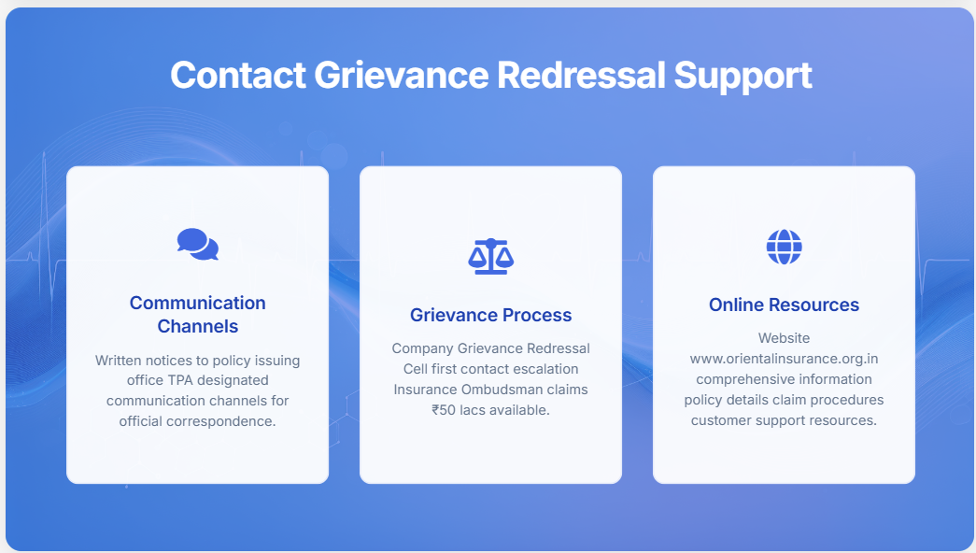
Notes:
https://app.powerbi.com/groups/me/reports/a1acbcca-df4c-40c8-a587-91405c143b3a/ReportSection33a4cc66ede13c4da0c0?experience=power-bi
B2C Dashboard – Akshay
Avg Consultation Cost

Slide 16

Notes:
https://app.powerbi.com/groups/me/reports/a1acbcca-df4c-40c8-a587-91405c143b3a/ReportSection33a4cc66ede13c4da0c0?experience=power-bi
B2C Dashboard – Akshay
Avg Consultation Cost

Slide 17
Thank You

